Slide 1
Angular
Install, App setup

Slide 2
Install Angular
As admin: Install angular cli globaly
npm install -g @angular/cli
Create new app
ng new ngsem201901
Run app
ng serve --open

Slide 3
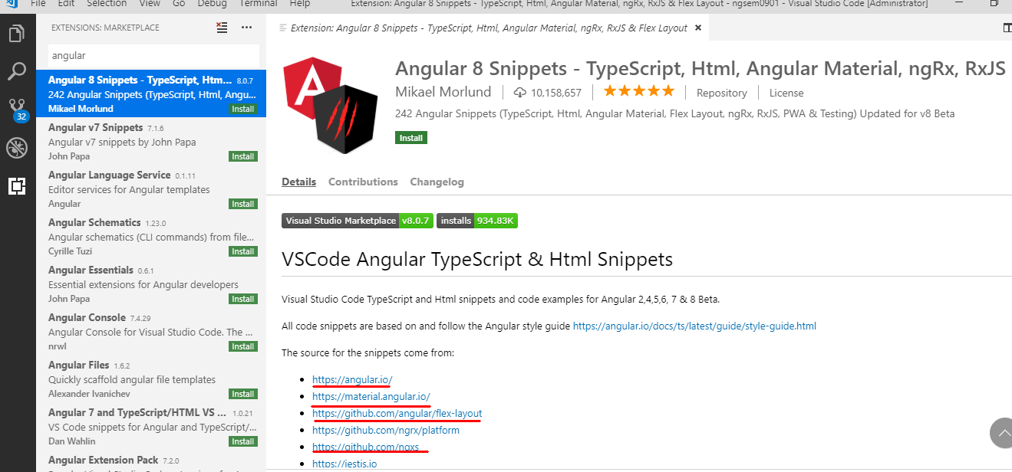
Instalar Complemento VS code

Slide 4
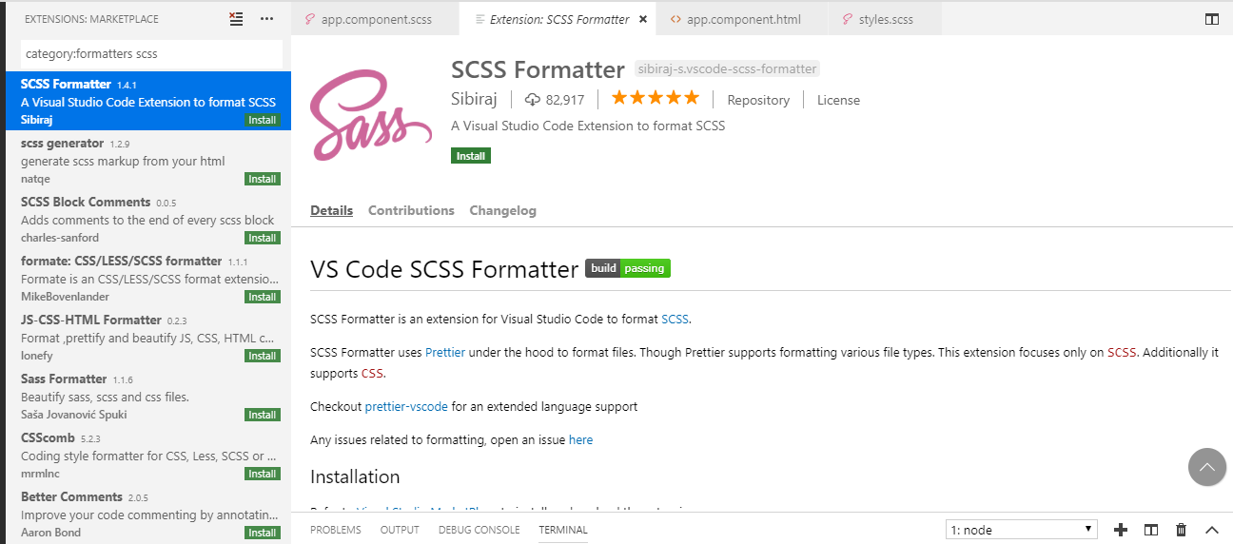
Instalar Complemento VS code

